Slide 1
Leveling up your Grafana skills
06 Dec. 2023

Slide 2
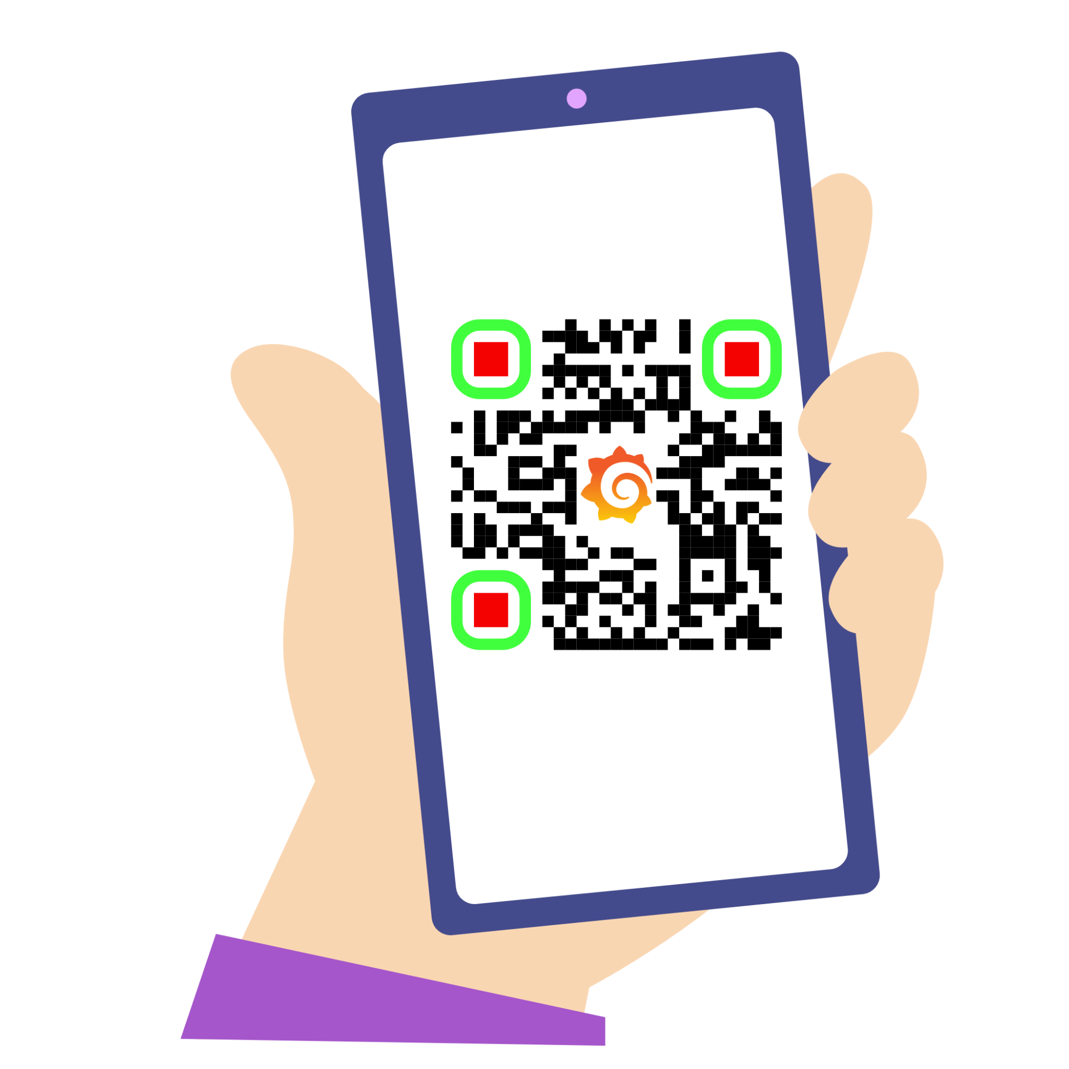

Presenter
About me
What I do?
My previous roles? What I do beside work?
Syed Usman Ahmad
Sr. Developer Advocate

Slide 3
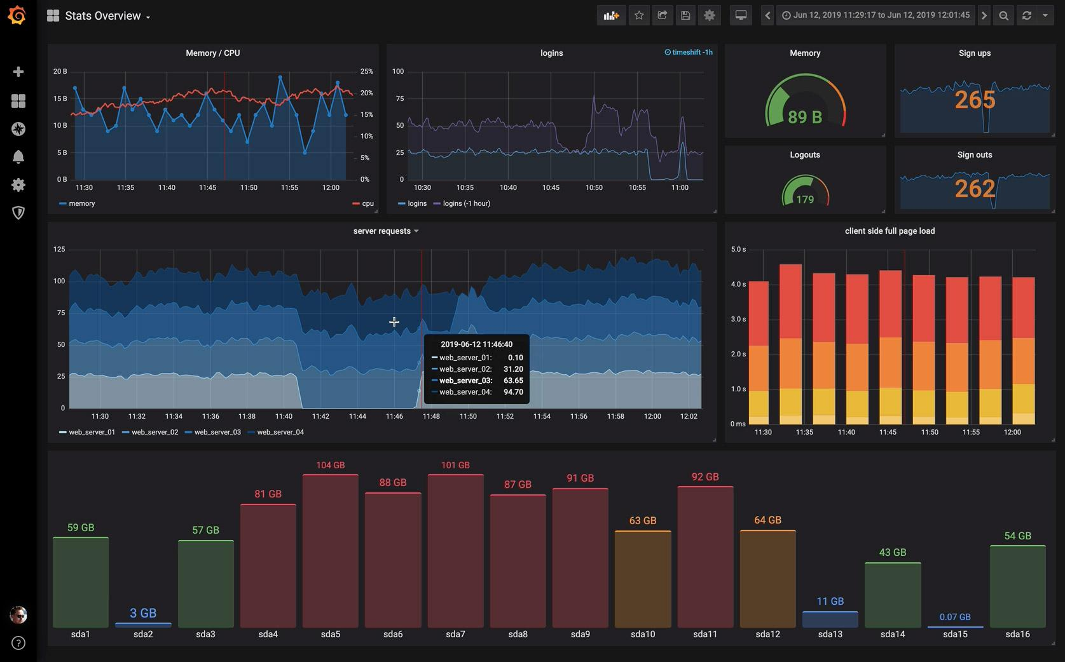
Why are we here today?
Notes:
Why do we need grafana ?
What happens without it. And show some screenshots.

Slide 4
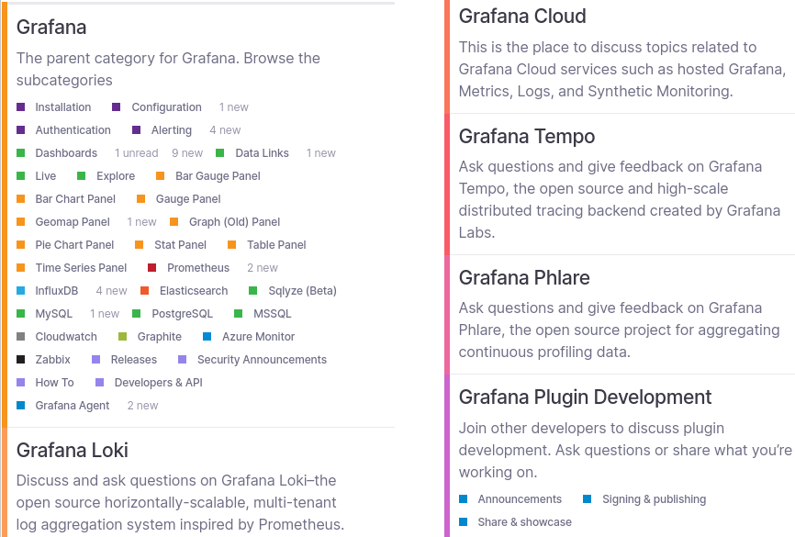
Lots of users traffic on daily basis
Notes:
How many x posts in a month/quarter in month? How do you make sense of what is going on ……

Slide 5
How to monitor the Community performance?
Notes:
Make similar patten on others

Slide 6

Discourse Data Explorer Plugin
1
Enables SQL queries against Backend DB
Supported by the Discourse API
2
3
Easy and powerful to get data

Slide 7
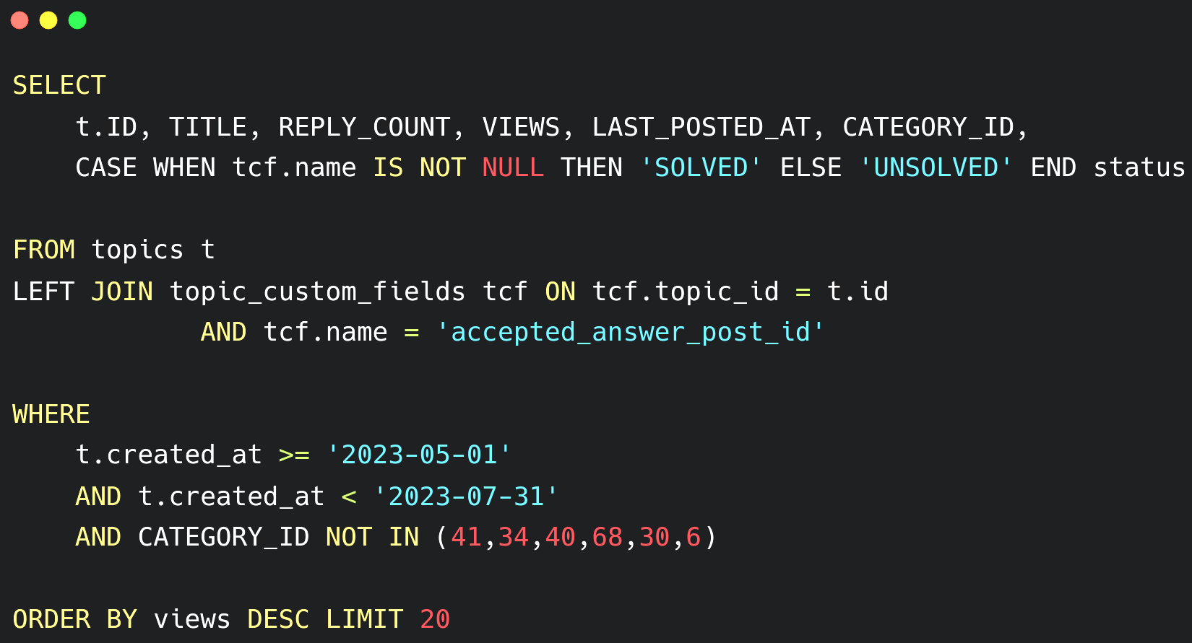
Example
SQL query to get the Top 20 posts

Slide 8
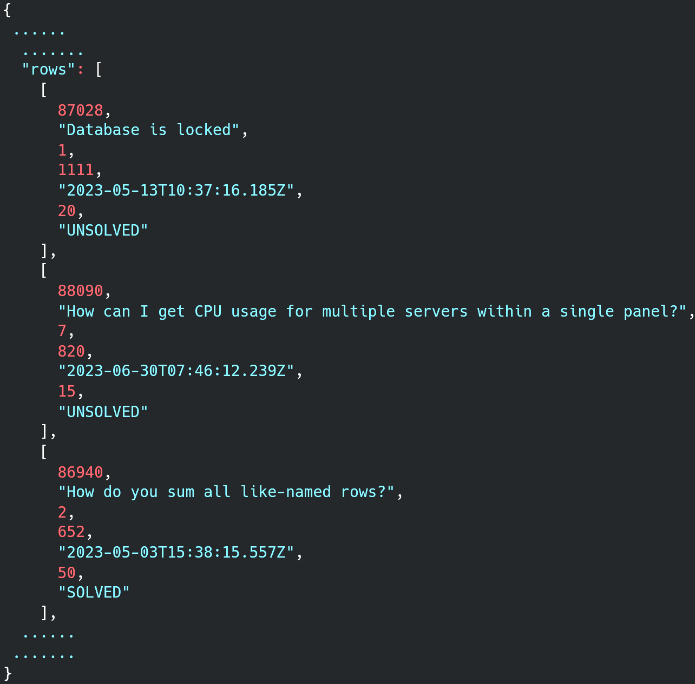
Example
JSON Result:

Slide 9
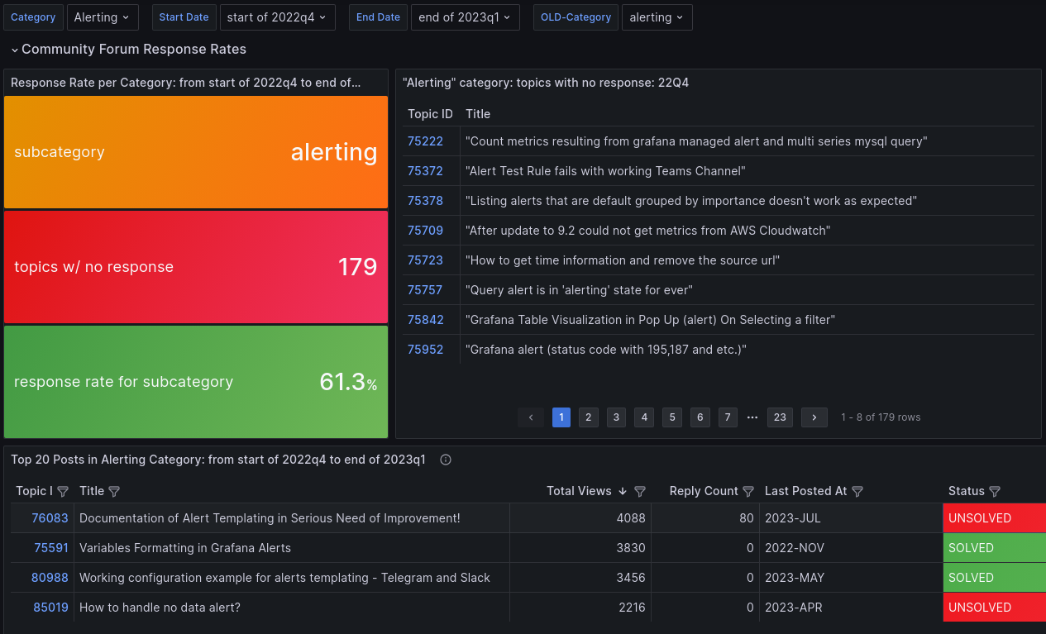
This is how we monitor the Community

Slide 10
How to do it?
Notes:
Make similar patten on others

Slide 11

Using Grafana
1
Available in both OSS and Enterprise versions
2
Support various Visualisation formats
3
Only need to connect to a Data source

Slide 12


Using Infinity plugin
Free to use
1
2
Support various data formats
3
Supports many Grafana features

Slide 13
How is it going to work?
Notes:
Make similar patten on others

Slide 14
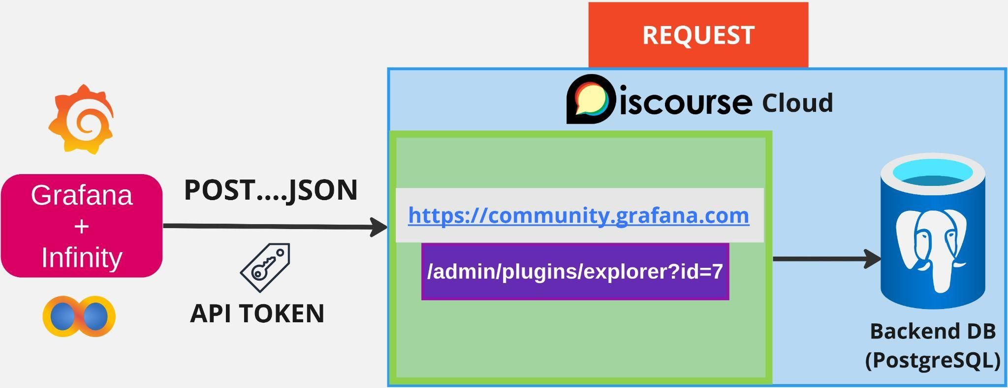
Sending Request

Slide 15
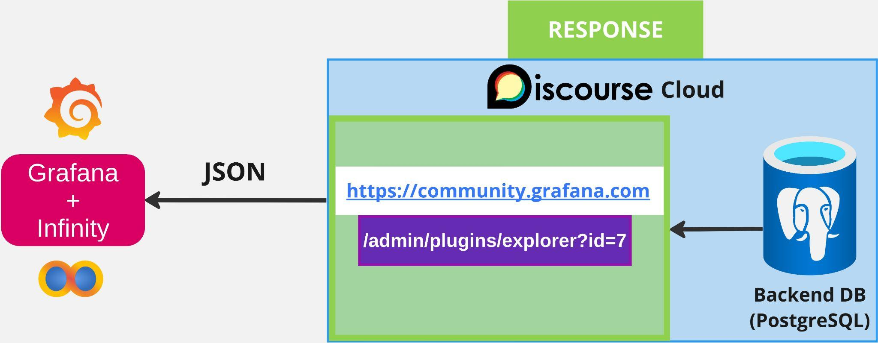
Receiving Response

Slide 16
Configuring Data source
Notes:
Make similar patten on others

Slide 17
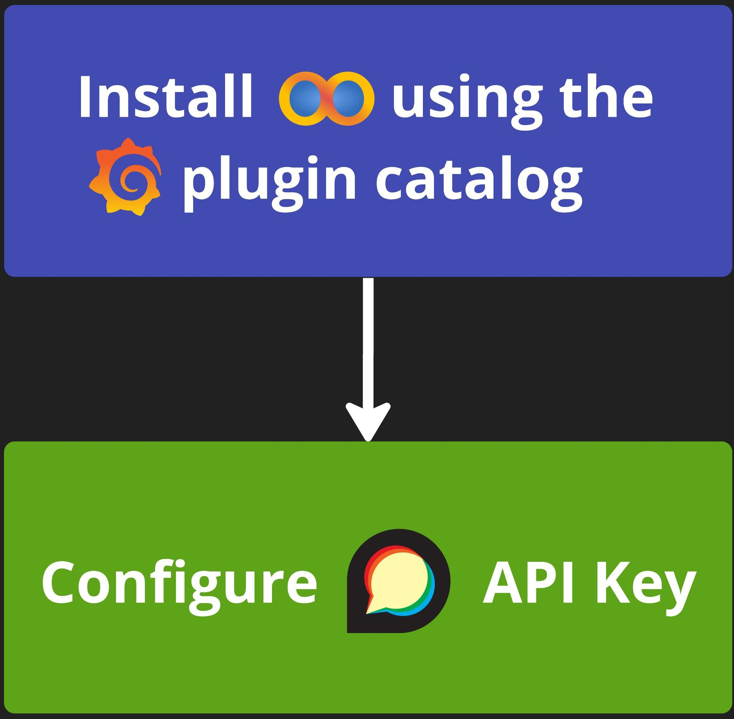
2 Step process

Slide 18
Creating a Dashboard panel
Notes:
Make similar patten on others

Slide 19
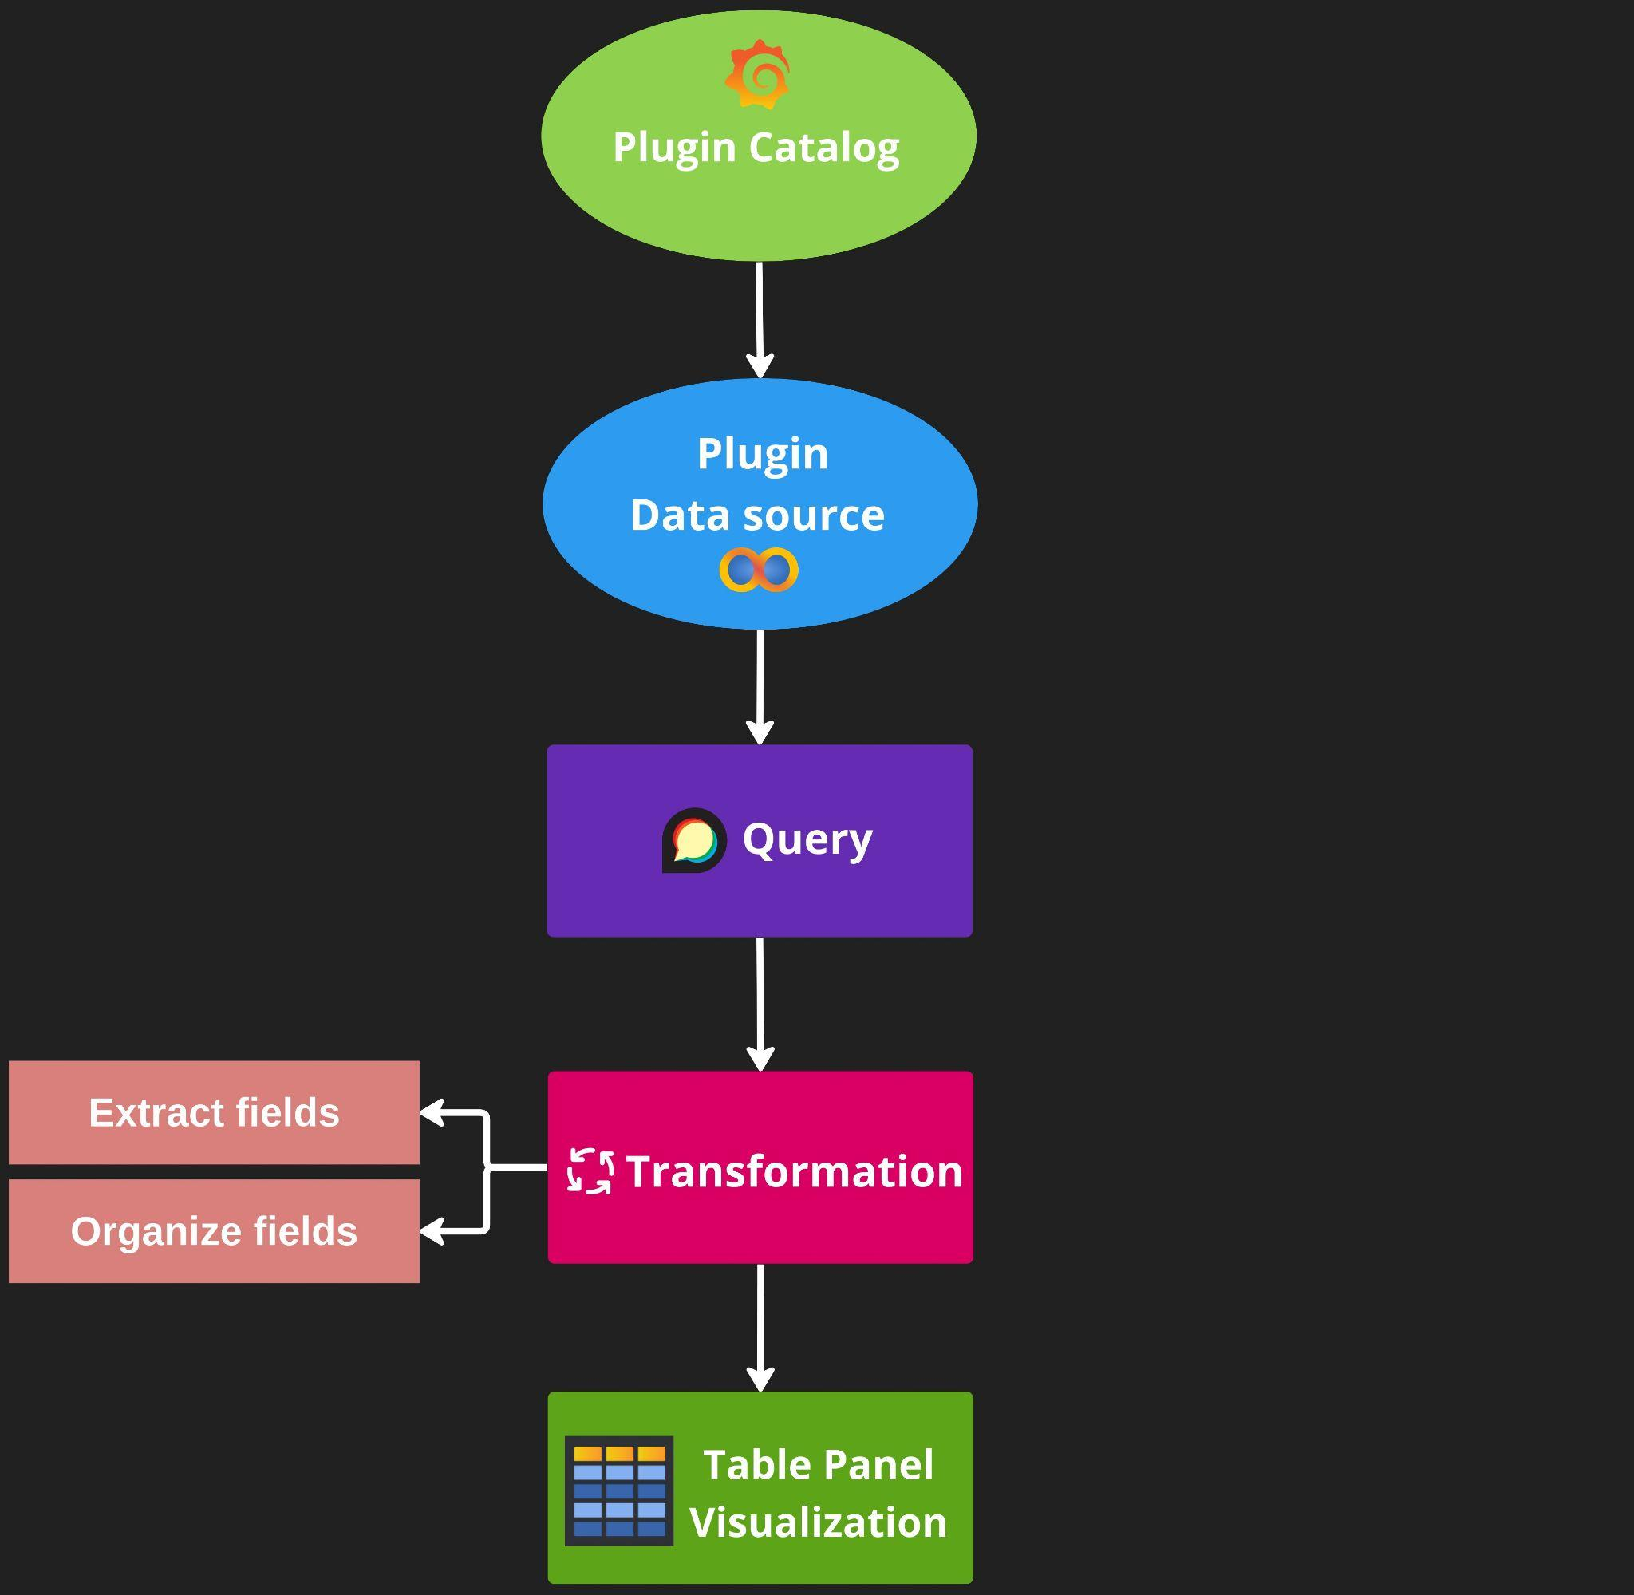

Slide 20
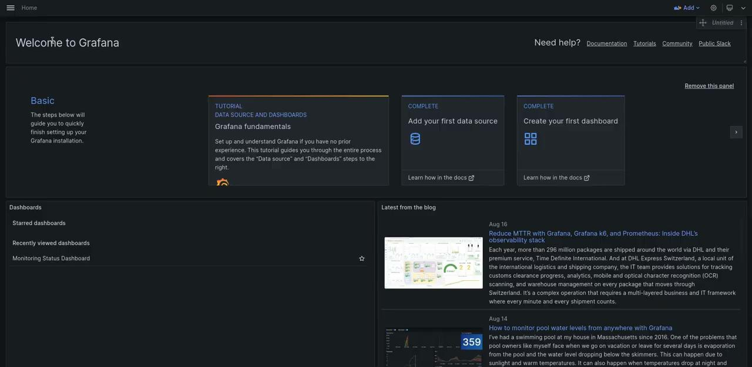
Setting up a Query panel

Slide 21
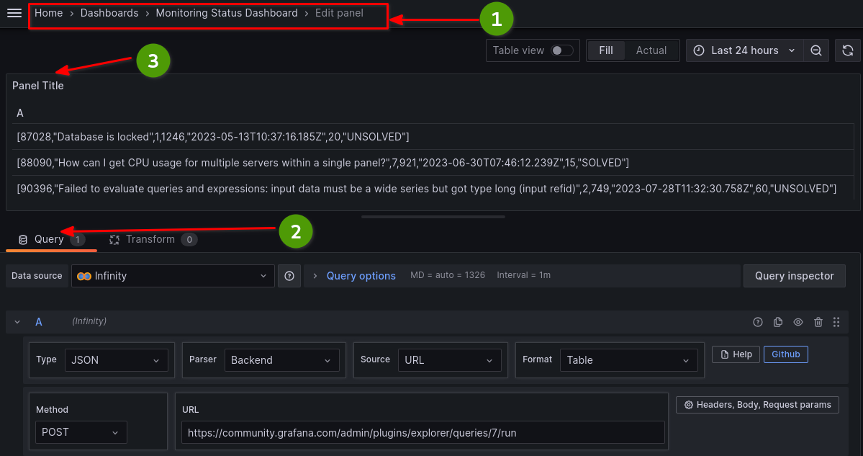
Defining query in the editor

Slide 22
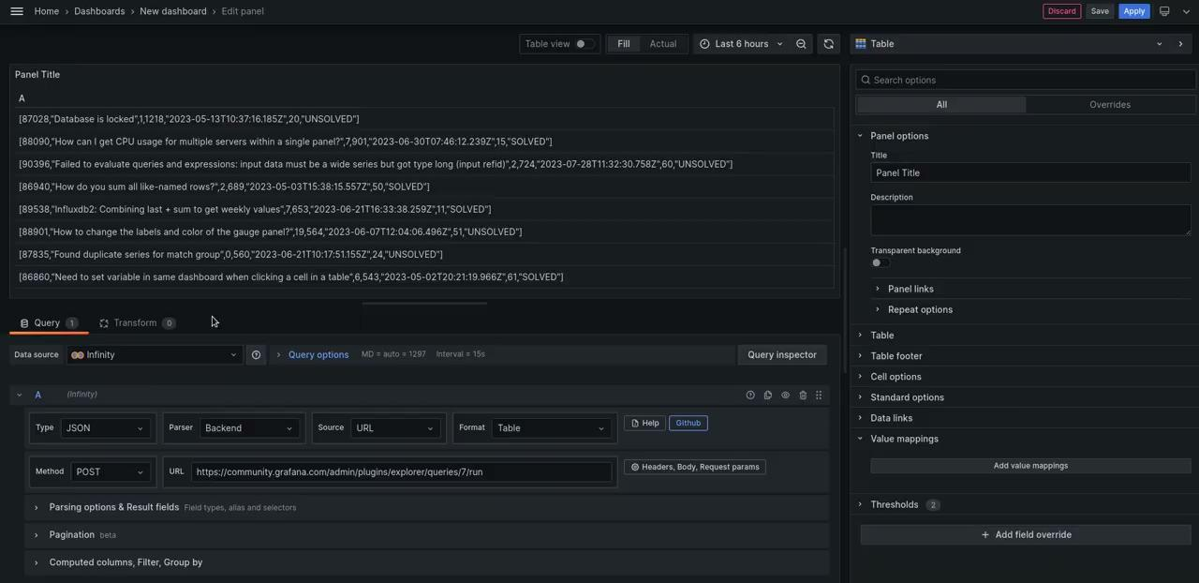
Transformation - Extract fields

Slide 23
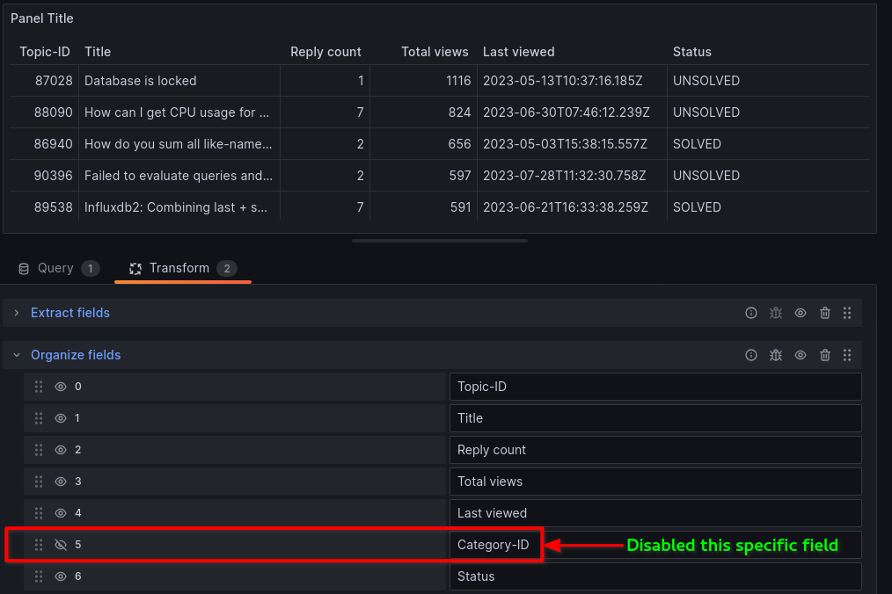
Transformation - Organize fields

Slide 24
Panel configurations
Notes:
Make similar patten on others

Slide 25
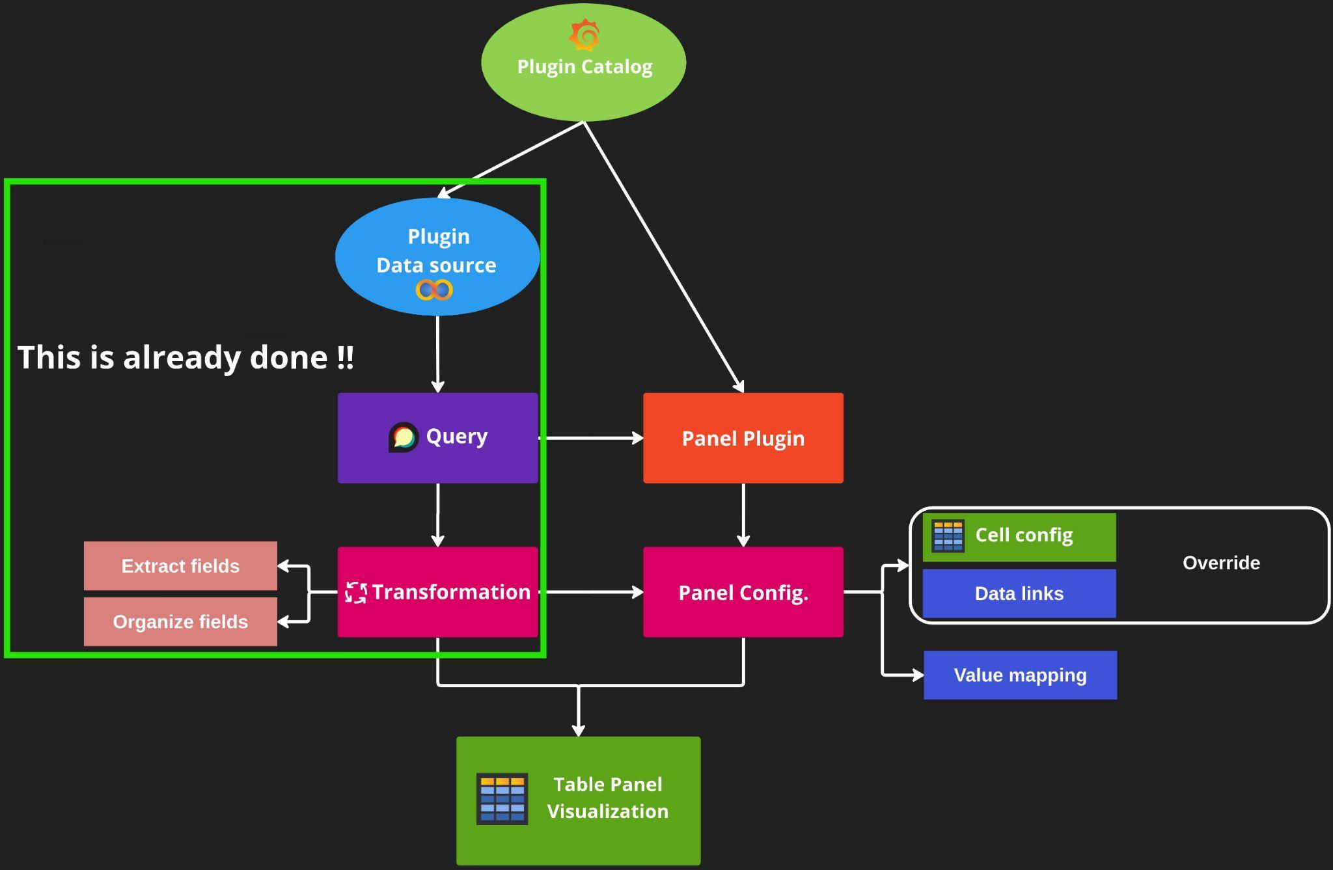

Slide 26
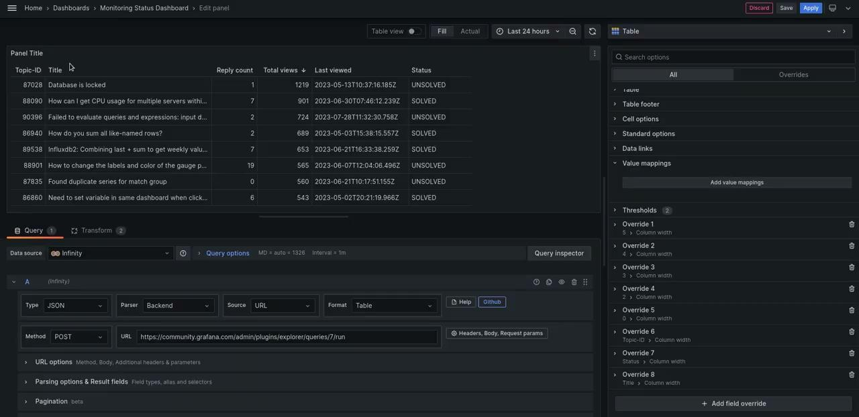
Using Override - Cell type

Slide 27
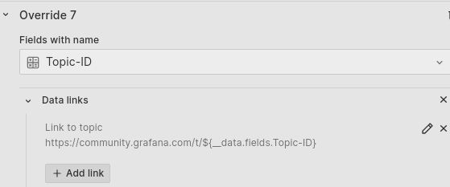
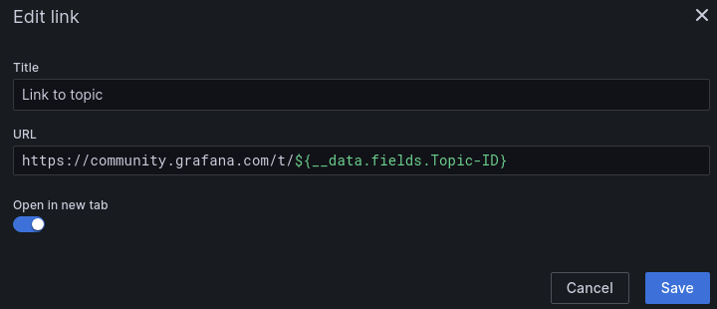
Using Override - Data links

Slide 28
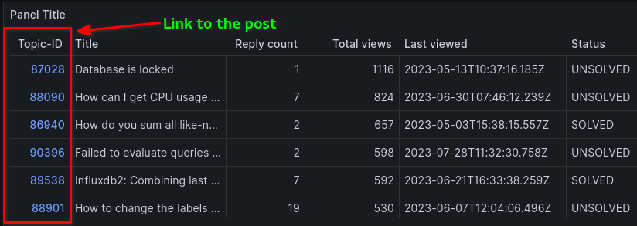
Using Override - Data links

Slide 29
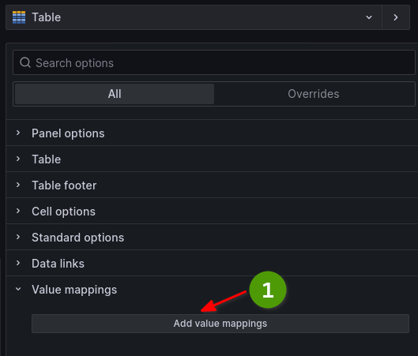
Using Value mapping

Slide 30
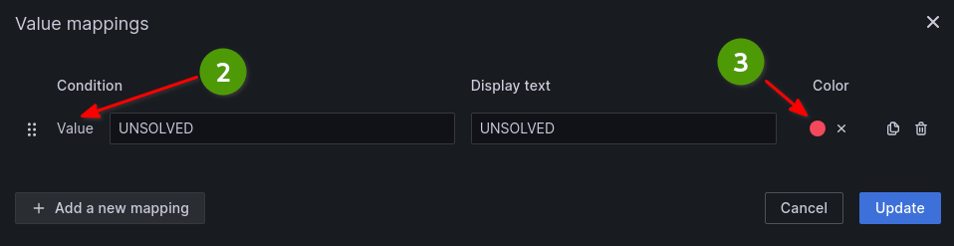
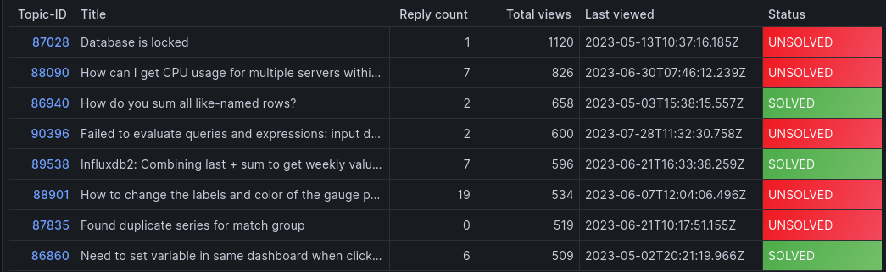
Using Value mapping

Slide 31
Dynamic dashboard variables
Notes:
Make similar patten on others

Slide 32
Dynamic dashboard variables
Global variables
Data source
Ad-hoc filters
Interval
Query
Constant
Chained variables
Custom
Text Box

Slide 33
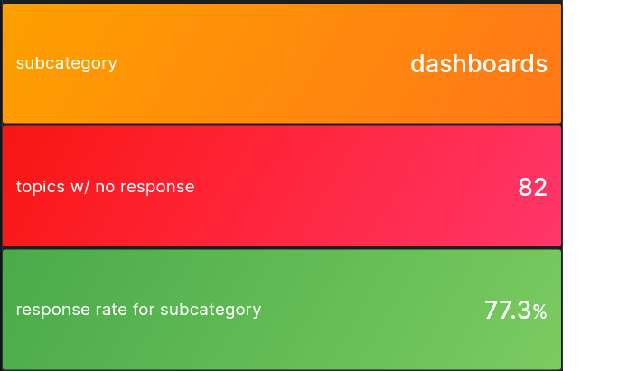
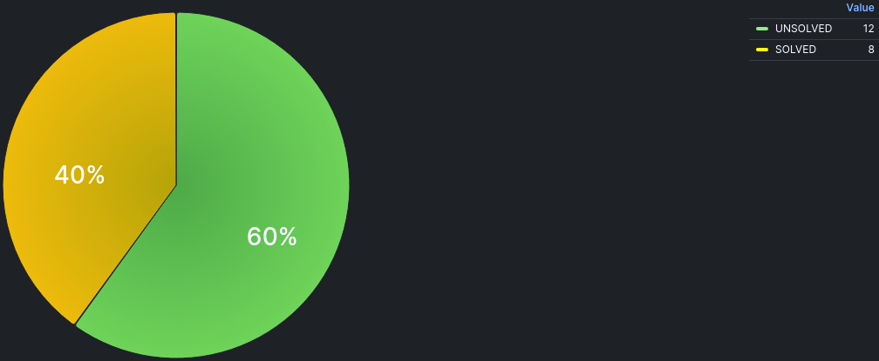
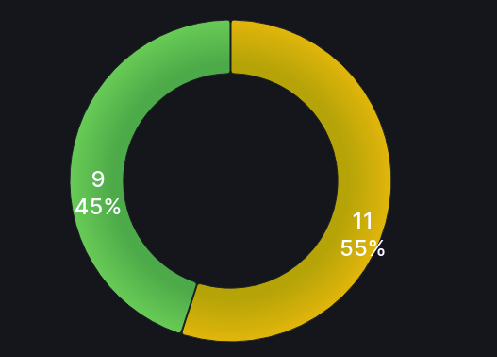
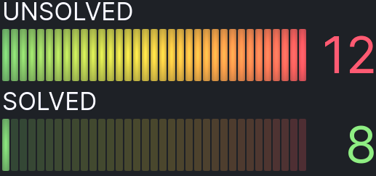
Using different Panel Visualisation

Slide 34

This is what you can design !!

Slide 35


Want to get involved?
1
To report bugs, feature-request:
grafana/grafana
GitHub repo
Slack channel #grafana
Community forum
2
Other useful resources:
#grafana
community.grafana.com

Slide 36


Thanks for
participating!
Contact me:
usman.ahmad@grafana.com
Syed Usman Ahmad

Slide 37


